Slide 1
A level Spanish
AS and A2

Slide 2
Who is this course suitable for?
If you have an interest and a desire to learn and
experience the world around you then you will
be well suited to this course. The AS course on its
own will provide you with a wealth of knowledge
and competency in Spanish for use in leisure,
however if you wish to specialise in Spanish at
degree level or equivalent you are advised to
complete the A2 units and obtain a full A Level
qualification.

Slide 3
Entry Requirements
7 GCSE’s A* - C and a very good GCSE standard or equivalent in Spanish.
You should have at least a grade B at GCSE level in order to study Spanish at AS level.
You should also have a desire to enhance your knowledge of the culture and society of Spain and communities where Spanish is spoken.

Slide 4
The AS course
Unit 1 – Speaking. This unit consists of a three minute presentation based on one of the topic areas followed by a general conversation for eight minutes.
Unit 2: Section A – Listening.
Section B – Reading comprehension and translation from Spanish to English.
Section C – Writing – an extended writing piece based on short films/literature

Slide 5
The A2 course
Unit 1 – Speaking. This unit consists of a five minute discussion based on a societal theme followed by a general conversation for eight to ten minutes. Societal themes include the study of a region in Spain, a cultural aspect or a historical period.
Unit 2: Section A – Listening.
Section B – Reading comprehension and translation from English to Spanish.
Section C – Writing – one extended writing question based on a literary text.

Slide 6
AS Topics you will study include:
Relationships – family structures, pressure on families, types of personal and interpersonal relationships and gender roles in society.
Health and lifestyle – physical and mental well-being, self harm and suicide, interests and entertainment, travel and contemporary issues.
Young people in society – influences on young people, popular culture and media, cultural identity, school life and career planning.

Slide 7
A2 Topics you will study include:
Local and global citizenship – equality and inequality, discrimination and prejudice, poverty, immigration, cultural differences and conflict.
Environmental awareness – conservation, pollution and waste, renewable energy sources and protection of the environment.

Slide 8
What are the benefits of studying Spanish?
During the course you will:
Develop the ability to communicate confidently and effectively in Spanish in both speech and writing.
Learn about the contemporary society, cultural background and heritage of Ireland and communities where Spanish is spoken.
Develop personally by strengthening your confidence and helping you gain a positive attitude to learning and independent study.
Explore and discuss contemporary societal issues through the medium of Spanish.
Explore an aspect of Spanish society and Spanish literature.

Slide 9
Key skills you will develop are:
Communication
Problem solving
Creativity
Working with others
Self-management
Independent study skills

Slide 10
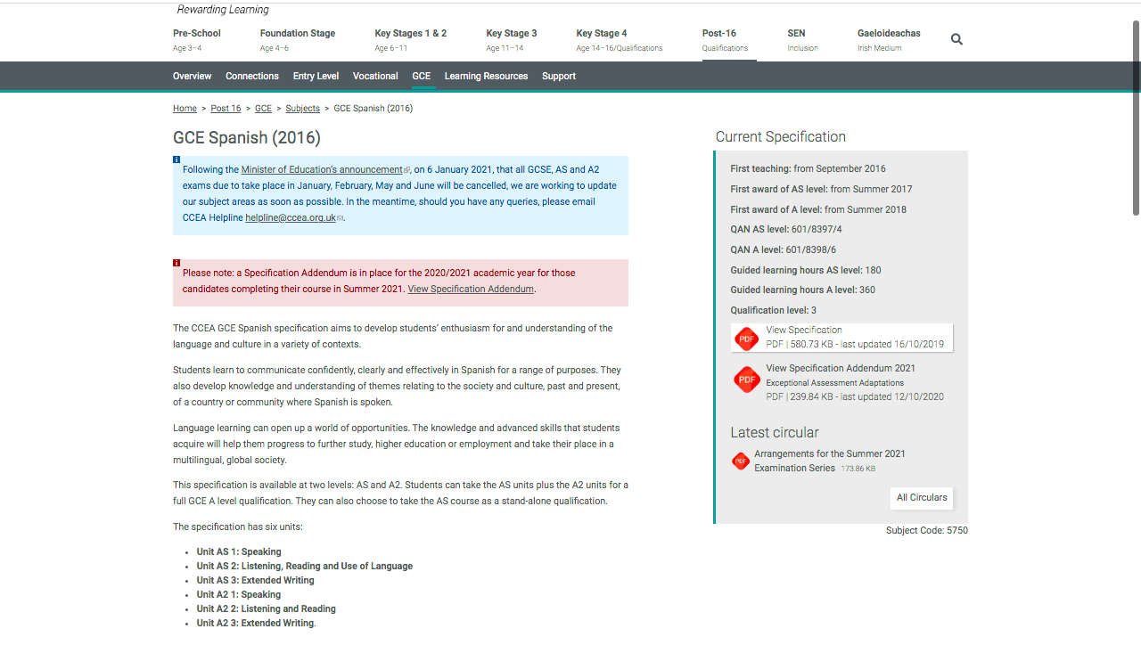
For further information go to…
https://ccea.org.uk/post-16/gce/subjects/gce-spanish-2016

Slide 11

Careers with Spanish
Spanish

Slide 12
Spanish in University
https://www.qub.ac.uk/courses/undergraduate/spanish-ba-r410/
https://www.tcd.ie/Hispanic_Studies/
http://www.stmarys-belfast.ac.uk/

